Slide 1
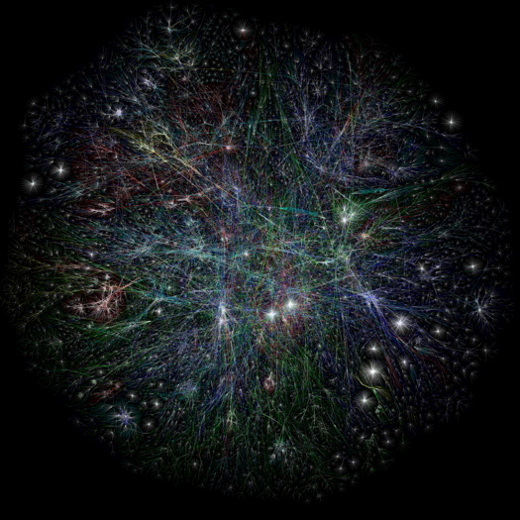
Web2.0

Slide 2
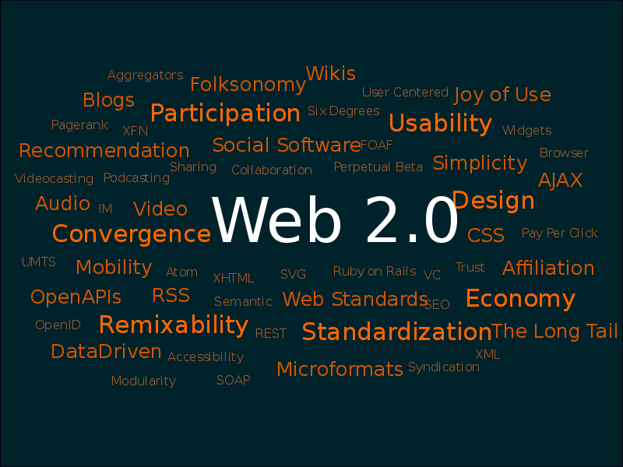

Slide 3
Web2.0 wikipedia definition
"Web 2.0" refers to what was perceived as a second generation of web development and web design. It is characterised as facilitating communication, information sharing, interoperability, and collaboration on the World Wide Web. It has led to the development and evolution of web-based communities, hosted services, and web applications. Examples include social-networking sites, video-sharing sites, wikis, blogs and folksonomies.

Slide 4
Web 2 is about online community, ‘participatory web’ and the sharing of information between equals.
Peer to Peer or P2P
Meritocracy, collaborative creation, syndicated content, jargon, buzzwords, and the newest killer app.

Slide 5
The Good
Lots of information spread across locations
The web is flatter, freer, faster, funner
Networks of people can be quickly gathered around interests or memes
Audience wants/expects to be able to interact, co create information
Multi dimensional aspect

Slide 6
The Bad
Tooo much information in too many places
LOLCatz syndrome
Attention spans are shrinking
People expect free
Loss of control
Lightning fast moving curve
No face to face = arguments

Slide 7
Technologies:
User generated content + cogenerated content
Audience polling, voting structure
Social networks
Blogs, microblogs
Photosharing, video sharing
Tagging
Collaboration and wikis
Instant messaging : gchat, skype, msn, facebook chat,

Slide 8
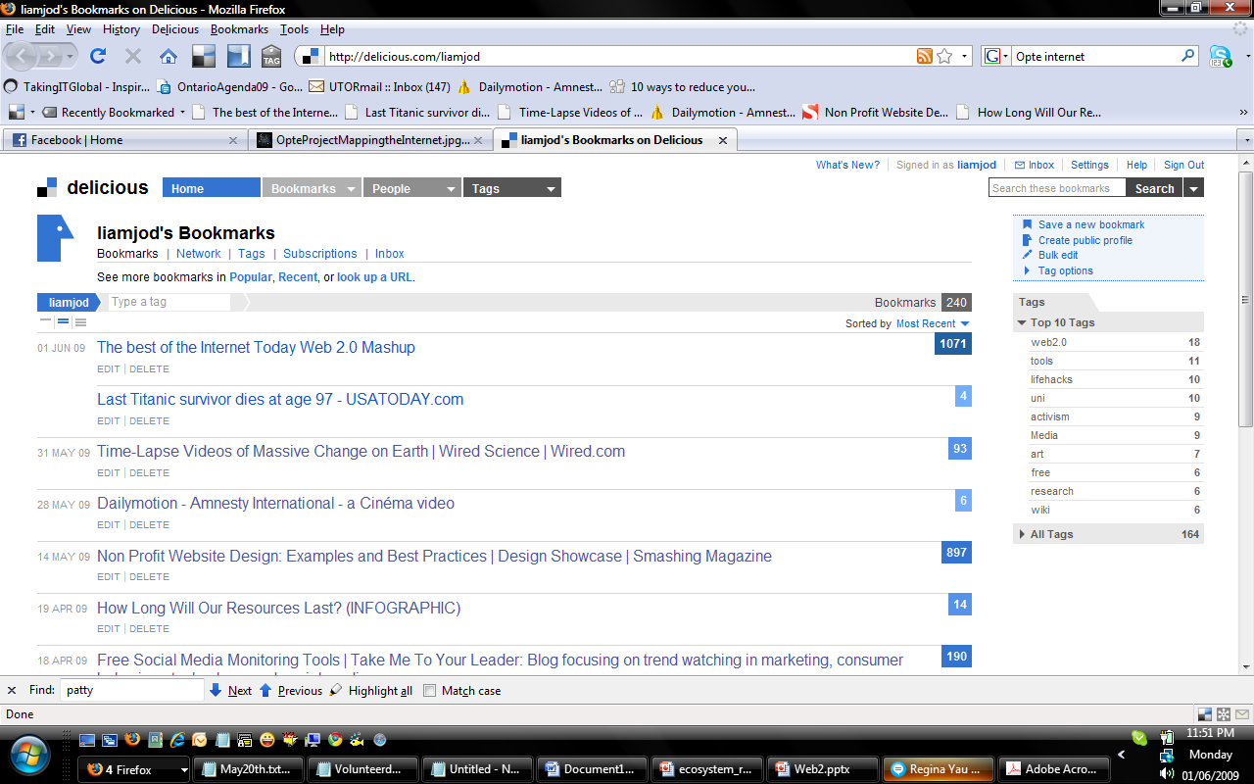

Slide 9
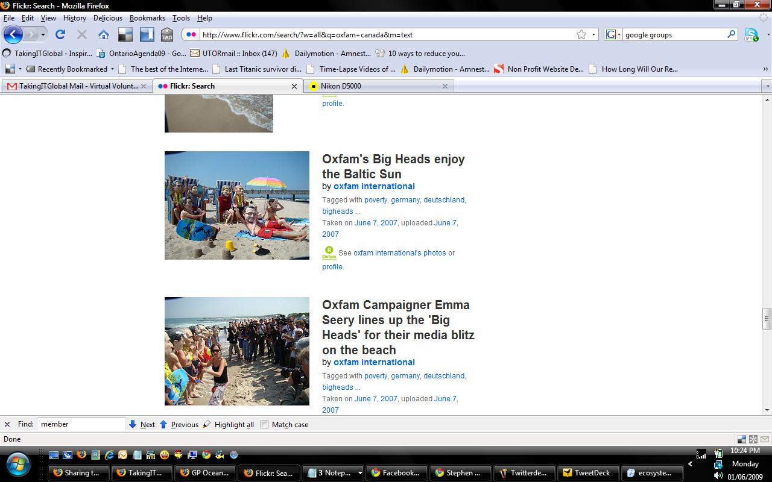

Slide 10
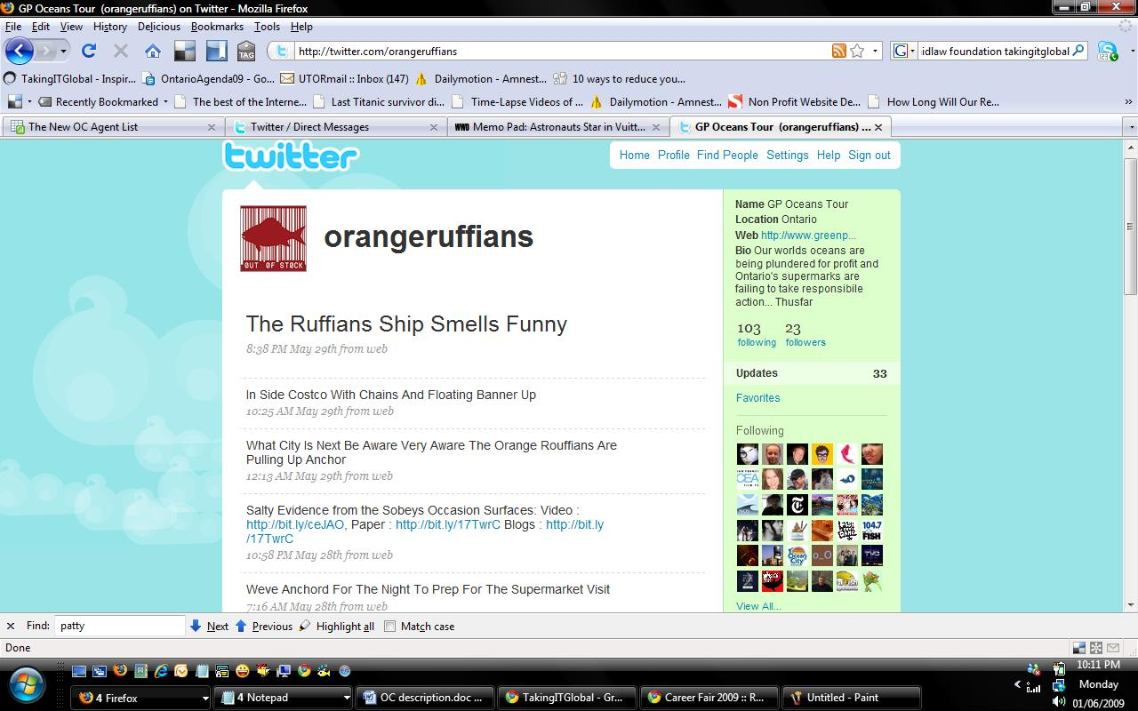

Slide 11
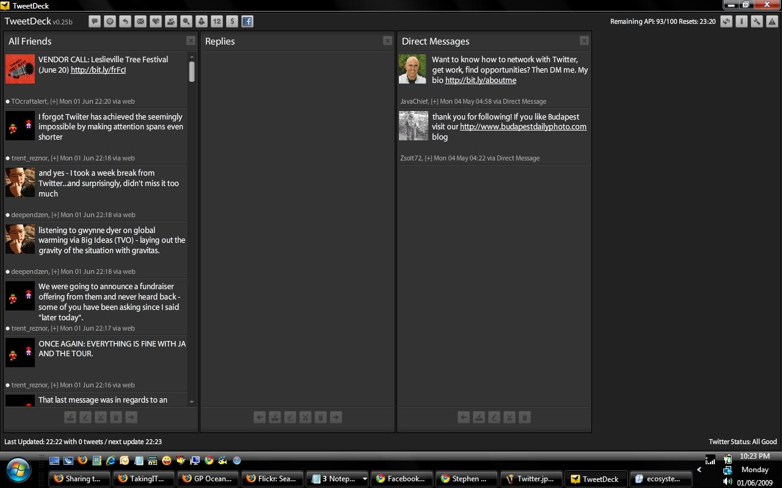

Slide 12
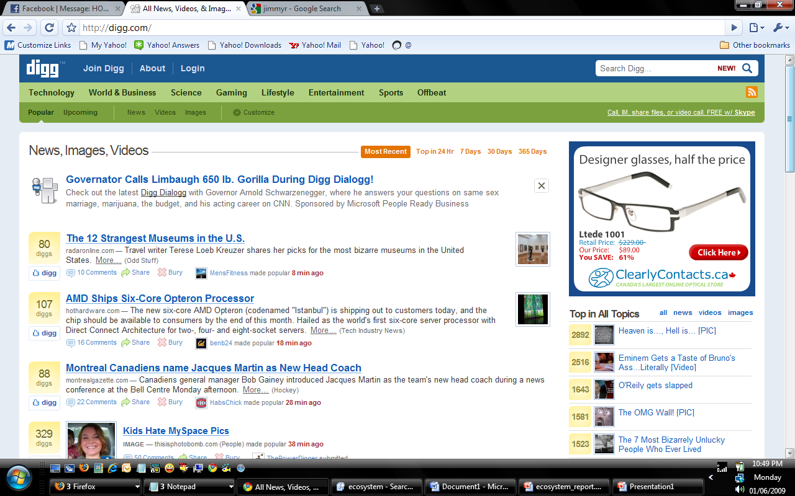

Slide 13
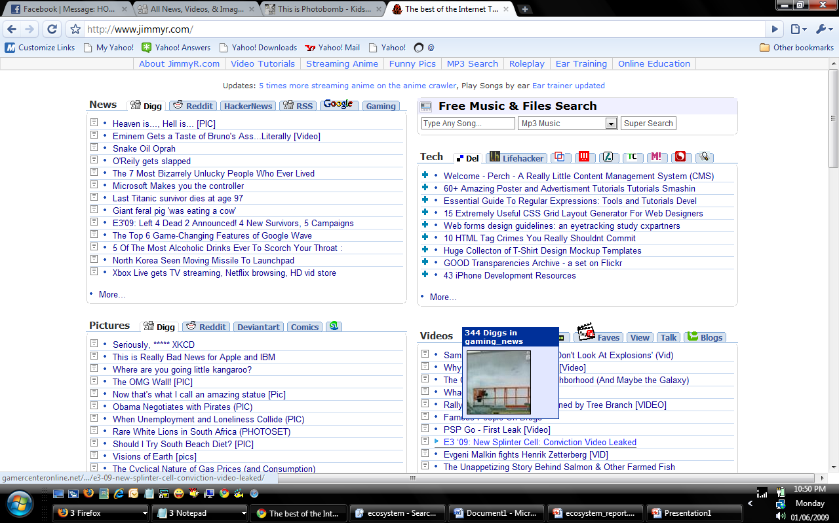

Slide 14
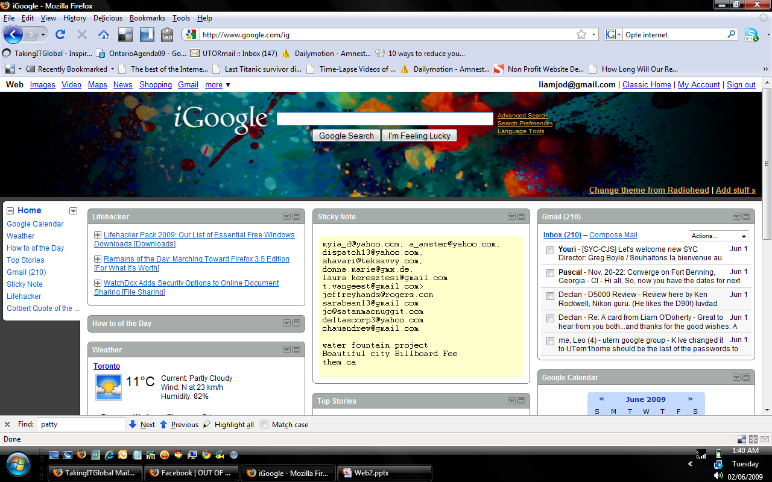

Slide 15
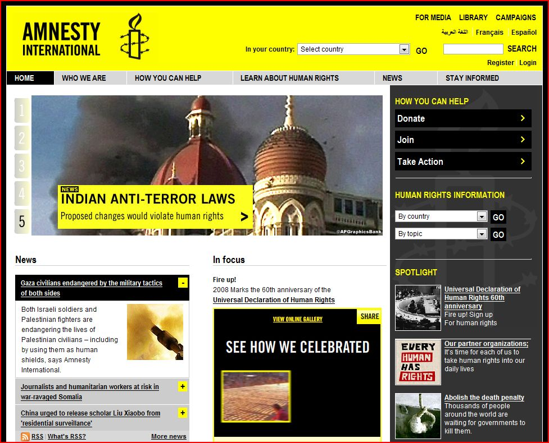

Slide 16
Amnesty International
Tech
Similar spotlight feature on main page
RSS feed of good news
Social bookmarking with Delicious, Digg, Facebook, Technorati
Site available in English, French, Arabic
Newsletter mailing list
Current appeals for action with counter tool for how many others have taken action.
Survey to collect data for the future of the organization
current campaigns:
Abolish the death penalty
Counter Terror with Justice
Stop Violence against Women
Control Arms
Celebrating the 60th Anniversary of Universal Declaration of Human Rights
Every Human has Rights (EHHR) - a coalition project in support of the UN declaration

Slide 17
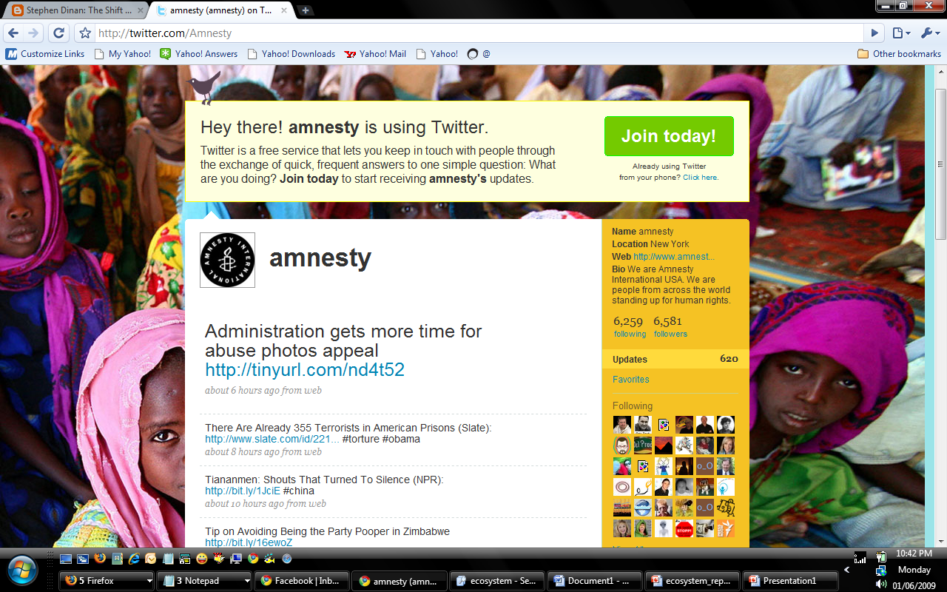

Slide 18
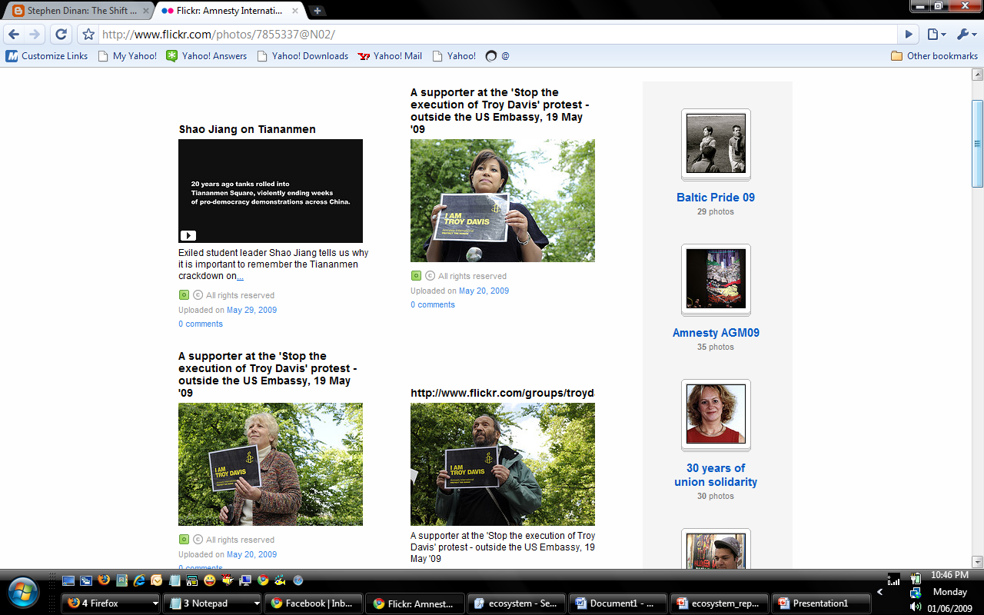

Slide 19
Thoughts:
Website as homebase for digital outreach
Engage your audience – decide who will have access to what
Have small teams bottomlining different tools, but encourage cross pollination
Social media “expert” role
Live chats with Oxfam celebrities – ask audience to send questions
Common aesthetic across platforms (where possible)

Slide 20
Where is this going?
Many directions at once
Citizen journalism
Collaboration everywhere
The walls between inside/outside of an organization or getting shorter
Multiple online identities
Mobile blogging
Quicker, faster, smaller, permanently connected
Constant availability
Mash ups: FML – GMH
Increasing social aspect: Kiva loans,

